Slide 1

Management Information Systems: Managing the Digital Firm
Chapter 3
Information Systems, Organizations, and Strategy

Slide 2
Learning Objectives
3-1 Which features of organizations do managers need to know about to build and use information systems successfully?
3-2 What is the impact of information systems on organizations?
3-3 How do Porter’s competitive forces model, the value chain model, synergies, core competencies, and network economics help companies develop competitive strategies using information systems?
Notes:
You could ask students to recall some concepts from the previous chapters that might help managers build and use information systems successfully. Answers could include what business processes the company performs, the size of the company, or the organization of the information systems function.

Slide 3
The Relationship Between Organizations and Information Technology
Information technology and organizations influence each other
Relationship influenced by organization’s
Structure
Business processes
Politics
Culture
Environment
Management decisions

Slide 4
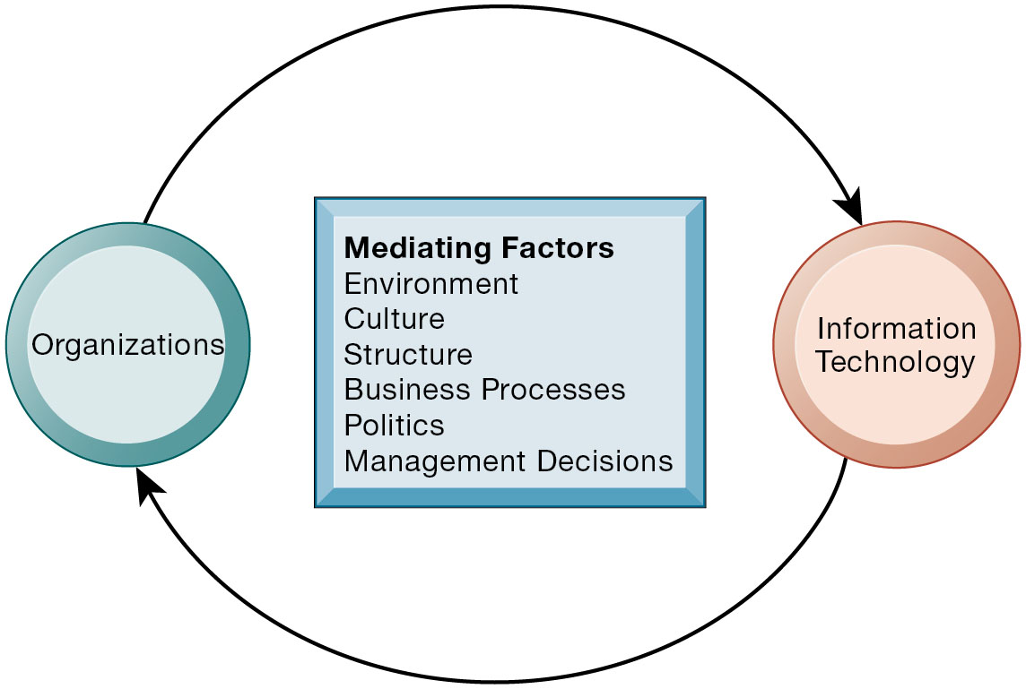
The Two-Way Relationship Between Organizations and Information Technology
Notes:
Figure 3.1, Page 81.
This complex two-way relationship is mediated by many factors, not the least of which are the decisions made—or not made—by managers. Other factors mediating the relationship include the organizational culture, structure, politics, business processes, and environment.
Ask students to explain how each factor might affect the relationship between organizations and information technology. Emphasize to students that the relationship between these two and its effects on the future of a business are difficult to predict. For example, very few people could have predicted the prominence of e-mail and instant messaging in business communication 15 years ago.

Slide 5
What Is an Organization?
Technical definition
Formal social structure that processes resources from environment to produce outputs
A formal legal entity with internal rules and procedures, as well as a social structure
Behavioral definition
A collection of rights, privileges, obligations, and responsibilities that is delicately balanced over a period of time through conflict and conflict resolution
Notes:
Which of the two definitions do students find more accurate and why? It is important to consider both definitions rather than exclusively use one at the expense of the other. The two definitions are complementary.

Slide 6
Figure 3.2: The Technical Microeconomic Definition of the Organization
Notes:
Figure 3.2, Page 82.
In the microeconomic definition of organizations, capital and labor (the primary production factors provided by the environment) are transformed by the firm through the production process into products and services (outputs to the environment). The products and services are consumed by the environment, which supplies additional capital and labor as inputs in the feedback loop.
Ask students what are the inputs from the environment? What do organizations output (goods and services). In this view, the organization or business firm is rather easily changed, and malleable. The organization is a collection of parts, like a machine, that can be rearranged as needed. There are no humans in this model, or if there are, they are assumed to be relatively simple.

Slide 7
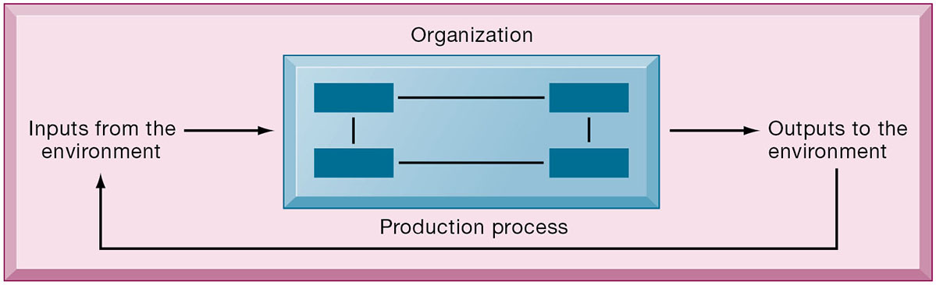
The Technical Microeconomic Definition of the Organization

Slide 8
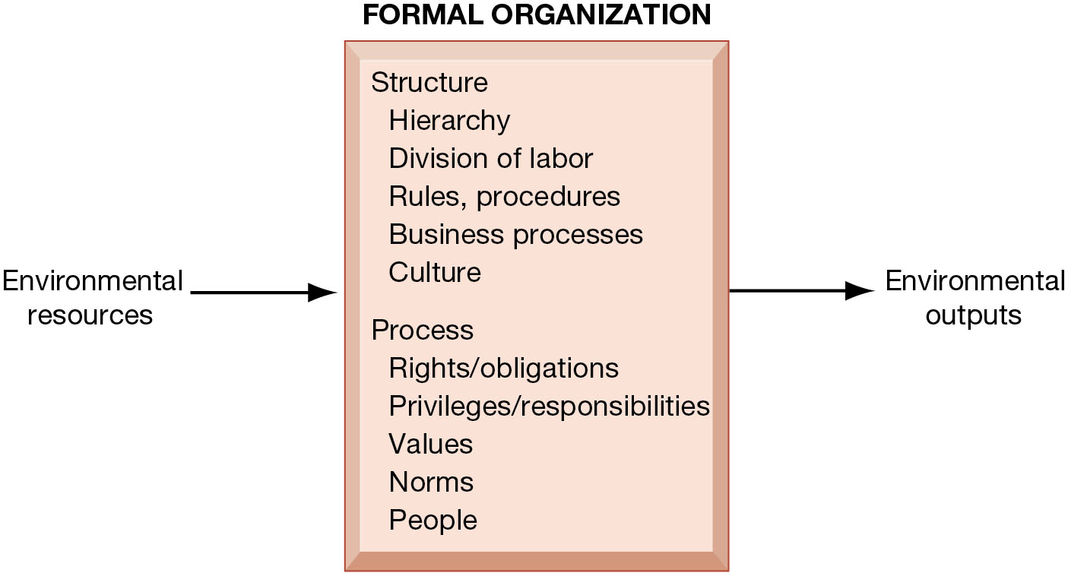
The Behavioral View of Organizations
Notes:
Figure 3.3, Page 83.
The behavioral view of organizations emphasizes group relationships, values, and structures.
In this view, the business firm is a little more difficult to change rapidly or on-command because it is a very complex machine populated with human beings. Firms operate with an existing hierarchy, job definitions, business rules, legal contracts, procedures, and processes. Efficient organizations become very good at these elements of business. Changing these elements takes more time.

Slide 9
Features of Organizations
Use of hierarchical structure
Accountability, authority in system of impartial decision making
Adherence to principle of efficiency
Routines and business processes
Organizational politics, culture, environments, and structures

Slide 10
Routines and Business Processes
Routines (standard operating procedures)
Routines for producing goods and services
Precise rules, procedures, and practices developed to cope with virtually all expected situations
i.e. visiting a doctor (receptionists, nurses, doctor)
Business processes: Collections of routines
Business firm: Collection of business processes

Slide 11
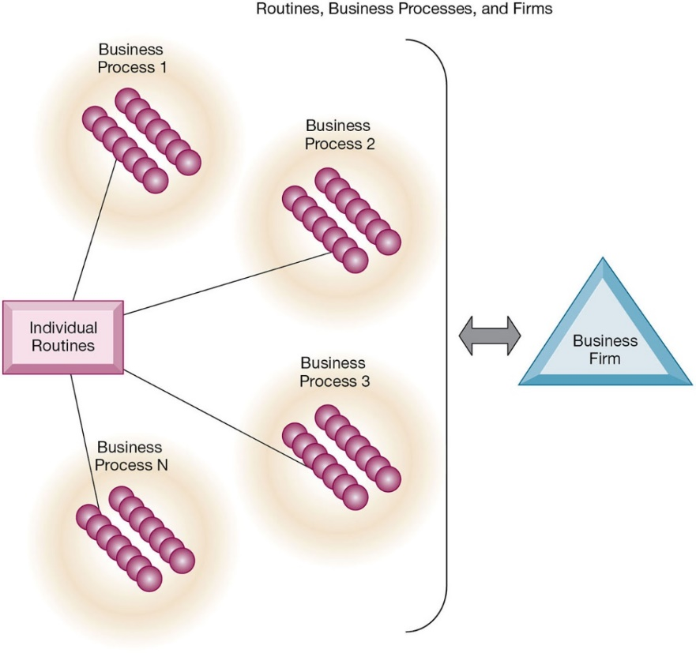
Routines, Business Processes, and Firms
Notes:
Figure 3.4, Page 85.
All organizations are composed of individual routines and behaviors, a collection of which make up a business process. A collection of business processes make up the business firm. New information system applications require that individual routines and business processes change to achieve high levels of organizational performance.
Explain to students that the blue spheres are individual routines, which together constitute a business process. A firm can be seen as a collection of these processes.

Slide 12
Organizational Politics
Different viewpoints/opinions lead to political struggle, competition, and conflict.
Political resistance greatly hampers (prevents) organizational change.
Notes:
You could ask students to describe examples where organizational politics might hamper a firm’s ability to succeed, or examples where effectively managed organizational politics helps a company to undergo a smoother transition or make more intelligent decisions. Ask students to describe their personal experiences with “organizational politics.”

Slide 13
Organizational Culture
Culture is the environment that surrounds you at work all of the time.
It is a set of assumptions that define goal and product
What products the organization should produce
How and where it should be produced
For whom the products should be produced
May be powerful unifying force as well as restraint on change

Slide 14
Organizational Environments
Organizations and environments have a reciprocal relationship (two-way influence).
Organizations are open to, and dependent on, the social and physical environment that surrounds them
Organizations can influence their environments i.e. business firms can work together to influence political process.
Environments generally change faster than organizations
Information systems can be instrument of environmental scanning, act as a lens
i.e. searching for and determining external changes that may require an organizational response; the current economic climate represents an example of external change that requires sweeping organizational responses to ensure survival.

Slide 15
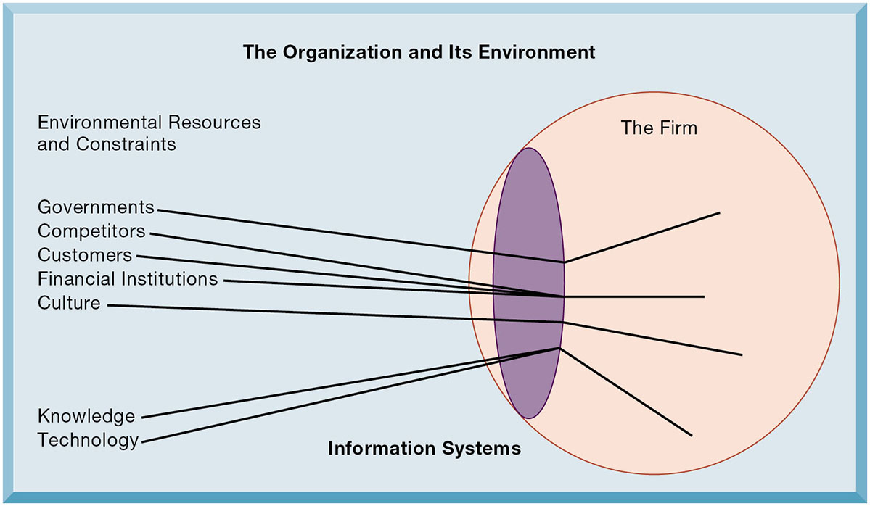
Environments and Organizations Have a Reciprocal Relationship
Notes:
Figure 3.5, Page 86.
Environments shape what organizations can do, but organizations can influence their environments and decide to change environments altogether. Information technology plays a critical role in helping organizations perceive environmental change and in helping organizations act on their environment.
This graphic further establishes information systems as the “lens” of the firm, observing external factors and filtering information back in to the firm. To some extent, organizations “see” only what their systems will let them see. If systems are poorly built, they may blind managers to difficulties and problems.

Slide 16
Disruptive Technologies
Technology that brings sweeping change to businesses, industries, markets
Substitute products that perform as well as or better than existing product (i.e. cars substitute horses, iTunes, Netflix)
Examples: personal computers, smartphones , Big Data and AI.
First movers and fast followers
First movers—inventors of disruptive technologies (i.e. Citi Bak ATM, Netscape Sony Walkman )
Fast followers—firms with the size and resources to capitalize on that technology (Business that recognizes others good ideas quickly and moves to implement them within the organization) Example: AWS, Samsung

Slide 17
Organizational Structure
Five basic kinds of organizational structure (Mintzberg)
Entrepreneurial: young, small, poorly designed system in a rush i.e. small startup firm
Machine bureaucracy: large bureaucracy, produce standard products, centralized i.e. manufacture firm
Divisionalized bureaucracy: multiple machine bureaucracy with each producing different product or service; in different locations, no single integrating IS (i.e. General Motors)
Professional bureaucracy: i.e. hospital, school, law firms
Adhocracy: Task force organization that must respond to rapidly changing environments , group of specialists, weak central management (consultancy firms)
Information system often reflects organizational structure

Slide 18
Other Organizational Features
Goals
Means to achieve them (Coercive: i.e. prison, utilitarian: i.e. business, normative: i.e. universities, and so on)
Constituencies (serve different groups): some benefiting their members, others benefiting their clients, stakeholders or the public
Leadership styles (i.e. democratic or authoritarian)
Types of tasks (task they perform or technology they use)
Different environments

Slide 19
1. Economic Impacts
IT changes relative costs of capital (buildings, machinery), labor and the costs of information
Information systems technology is a factor of production that can be substitute for traditional capital and labor
IT affects the cost and quality of information and changes economics of information
Information technology helps firms contract in size because it can reduce transaction costs (the cost of participating in markets)
Outsourcing
Notes:
IT figures to replace the function of more middle managers as time passes, as well as reduce the need for other forms of capital (buildings, machinery). Ensure that students understand what is meant by “economics of information” and why outsourcing is a possibility due to IT.

Slide 20
A. Transaction Cost Theory
Firms seek to economize on transaction costs (the costs of participating in markets)
Vertical integration, hiring more employees, buying suppliers and distributors
IT lowers market transaction costs, making it worthwhile for firms to transact with other firms rather than grow the number of employees, e.g.: outsource

Slide 21
B. Agency Theory (=Principle-Agency Theory)
Principle = owner; Agency= employee
A company is a collection of deals between people looking out for their own interests who need overseeing.
Firms experience agency costs (the cost of managing and supervising = cost of internal management) which rise as firm grows
IT can reduce agency costs, making it possible for firms to grow without adding to the costs of supervising, and without adding employees

Slide 22
2. Organizational and Behavioral Impacts
IT flattens organizations
Decision making is pushed to lower levels (i.e. banks)
Fewer managers are needed (IT enables faster decision making and increases span of control)
i.e. mangers can manage and control more workers in different locations
Postindustrial organizations
Organizations flatten because in postindustrial societies, authority increasingly relies on knowledge and competence rather than formal positions
i.e. consultancy firm: consultants tend to be self-managing, decision making is decentralized

Slide 23
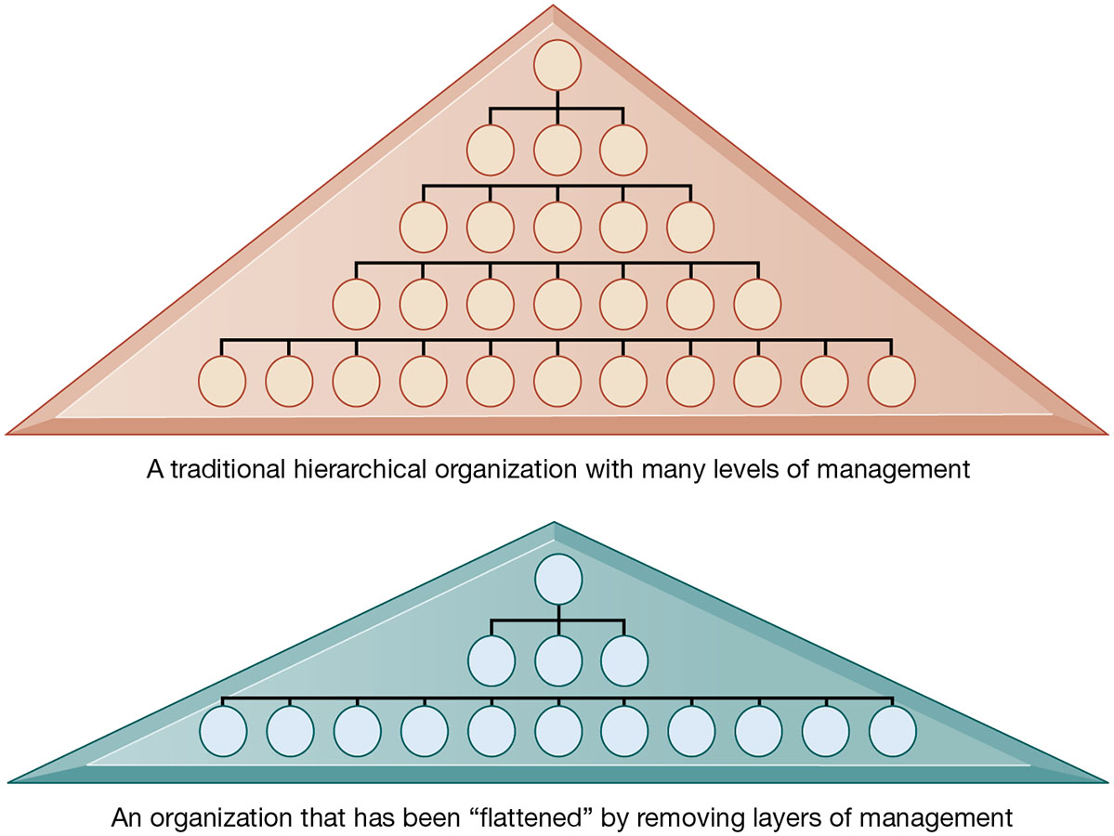
Flattening Organizations
Notes:
Figure 3.6, Page 91
Information systems can reduce the number of levels in an organization by providing managers with information to supervise larger numbers of workers and by giving lower-level employees more decision-making authority.
Ask students to explain some of the benefits of the flattened organization as opposed to the more complicated hierarchy in the top of the diagram. Information travels through fewer levels to its intended recipients; there are fewer managers, so agency costs are smaller, and firms can act faster (less decision delay).

Slide 24
Understanding Organizational Resistance to Change
Information systems become bound up in organizational politics because they influence access to a key resource—information
Information systems potentially change an organization’s structure, culture, politics, and work
Four factors influence the resistance to change:
Nature of the IT innovation
Structure of organization
Culture of people in the organization
Tasks affected by innovation
The only way to bring change is to change all (4) at the same time
Notes:
Explain what is meant by changes in culture and politics of the firm. For example, workers may resist changes that disrupt their routines. Also explain to students that as important as technical understanding of information systems may be for potential managers, it is equally important to understand the people and organizational structures and customs affected by information systems.

Slide 25
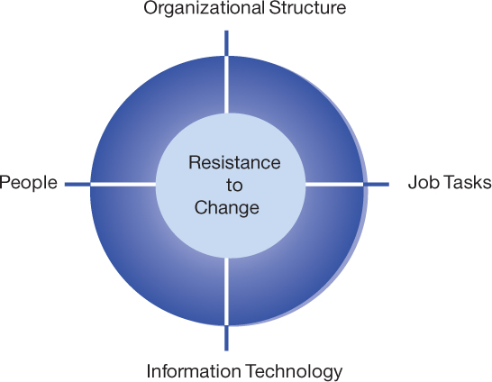
Organizational Resistance to Information System Innovations
The only way to bring change is to change all (4) at the same time

Slide 26
The Internet and Organizations
The Internet should also have a flattening effect on many organizations
The Internet increases the accessibility, storage, and distribution of information and knowledge for organizations
The Internet can greatly lower transaction and agency costs
Example: Large firm delivers internal manuals to employees via a corporate website, saving millions of dollars in distribution costs
Notes:
The Internet should also have a flattening effect on many organizations. Can students describe any businesses that have become more efficient and flat thanks to successful incorporation of the Internet in their operations? Some older students may remember the “bad old days” when seven or more levels of management needed to decide even simple issues in a typical firm. Many Fortune 1000 firms are still like this.

Slide 27
Porter’s Competitive Forces Model (1 of 3)
Why do some firms become leaders in their industry?
i.e. Amazon, iTunes, Netflix, Google
Michael Porter’s competitive forces model
Provides general view of firm, its competitors, and environment
Five competitive forces shape fate of firm:
Traditional competitors
New market entrants
Substitute products and services
Customers
Suppliers

Slide 28
Porter’s Competitive Forces Model (2 of 3)
Traditional competitors
All firms share market space with competitors who are continuously devising new products, services, efficiencies, and switching costs
New market entrants
Some industries, its easier to get into business i.e. pizza restaurant
Some industries have high barriers to entry, for example, computer chip business
New companies have new equipment, younger workers, inexpensive and innovative - but little brand recognition
Notes:
Ask students to name different industries and describe the benefits and drawbacks of being a new market entrant in each industry.

Slide 29
Porter’s Competitive Forces Model (3 of 3)
Substitute products and services
Substitutes customers might use if your prices become too high, for example, iTunes substitutes for CDs
Customers
Can customers easily switch to competitor's products? Can they force businesses to compete on price alone in transparent marketplace?
Suppliers
Market power of suppliers have a significant impact on firm profit (when firm cannot raise prices as fast as suppliers)…
the more suppliers, the greater control over price, quality and delivery.
Notes:
Ask students to name different businesses and describe whether or not customers have great control over the business or vice versa, or whether substitute products are a large or insignificant threat to the success of the business.

Slide 30
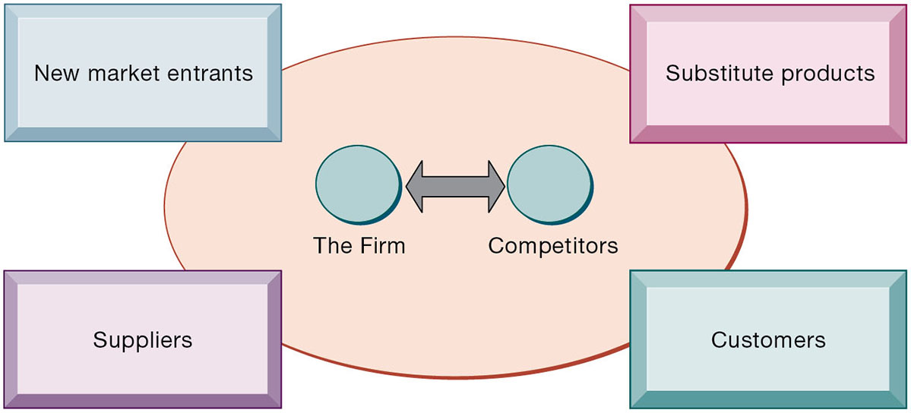
Porter’s Competitive Forces Model
Notes:
Figure 3.8, Page 96.
In Porter’s competitive forces model, the strategic position of the firm and its strategies are determined not only by competition with its traditional direct competitors but also by four other forces in the industry’s environment: new market entrants, substitute products, customers, and suppliers.
Notice that in the graphic, competitors are represented differently than the other four competitive forces influencing a firm. Why do students think this is the case? One answer might be that competitors are firms in the same industry and are under similar pressures as other firms in the industry.

Slide 31
Information System Strategies for Dealing with Competitive Forces (1 of 3)
Four generic strategies for dealing with competitive forces, enabled by using IT:
Low-cost leadership
Product differentiation
Focus on market niche
Strengthen customer and supplier intimacy

Slide 32
Information System Strategies for Dealing with Competitive Forces (2 of 3)
Low-cost leadership
Produce products and services at a lower price than competitors
Example: Walmart’s efficient customer response system/ no large store or inventory is needed (https://www.youtube.com/watch?v=SUe-tSabKag&t=115s)
Product differentiation
Enable new products or services, greatly change customer convenience and experience (difficult or hard for others to copy)
Example: Google (google maps), Nike (sneakers), Apple (iPod, iPhone, iPad), PayPal, eBay
Mass customization: Nike customize sneakers (customers orders customized sneakers using NIKEiD program on its website……process the order in its headquarter…..customer receive it in 3 weeks). https://www.youtube.com/watch?v=yVd-qTiExpg

Slide 33
Information System Strategies for Dealing with Competitive Forces (3 of 3)
Focus on market niche
Use information systems to enable a focused strategy on a single market niche; specialize
Data come from: i.e. credit card, purchase data, websites
Example: Hilton Hotels’ OnQ system
Strengthen customer and supplier intimacy
Use information systems to develop strong ties and loyalty with customers and suppliers
Increase switching costs
Examples: Toyota, Amazon

Slide 34
The Internet’s Impact on Competitive Advantage
Transformation or threat to some industries
Examples: travel agency, printed encyclopedia, media
Competitive forces still at work, but rivalry more intense
Internet is based on Universal standards that allows new rivals, new entry to the market, compete on price alone
New opportunities for building brands and loyal customer bases (i.e. Amazon, eBay, iTunes, Facebook, Google)

Slide 35
Smart Products and the Internet of Things
Internet of Things (IoT)
Growing use of Internet-connected sensors in products
Smart products
Fitness equipment, health trackers
Expand product differentiation opportunities
Increasing rivalry between competitors
Raise switching costs
Inhibit new entrants
May decrease power of suppliers

Slide 36
The Business Value Chain Model
Views the Firm as a series of activities that add value to products or services
Highlights specific activities in the business where competitive strategies can best be applied
Primary activities (directly related to the production and distribution of the firms products and services which create value for the customer) vs.
support activities (make the delivery of the primary activities possible)
At each stage, determine how information systems can improve operational efficiency and improve customer and supplier intimacy
It will cause in utilizing benchmarking and identifying industry best practices (see what others are doing)
Notes:
How does the value chain model differ from the Porter model? (It offers more specific detail about what exactly to do to achieve competitive advantages.) How do primary activities differ from support activities?

Slide 37
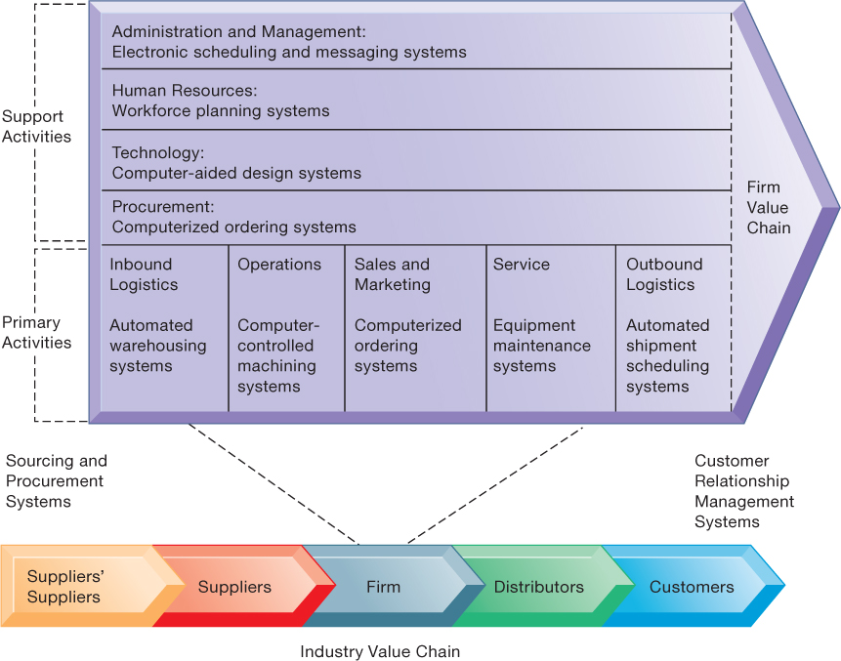
The Value Chain Model

